Slide 1

Max entropy VS. Otsu for thresholding

Slide 2
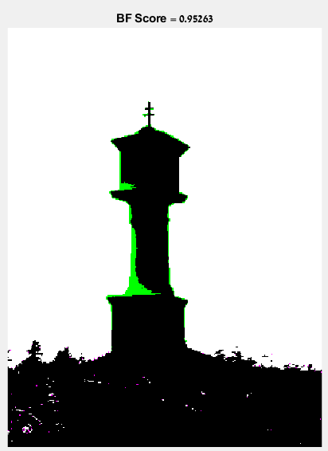
Results- Otsu VS. ground truth image
Using bfscore built-in function in MATLAB:

Slide 3
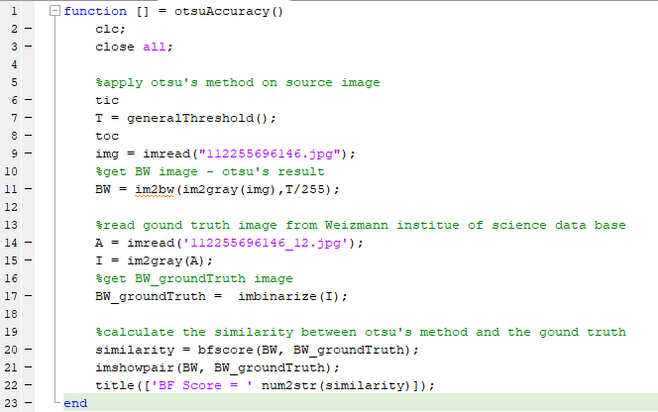
Code:

Slide 4
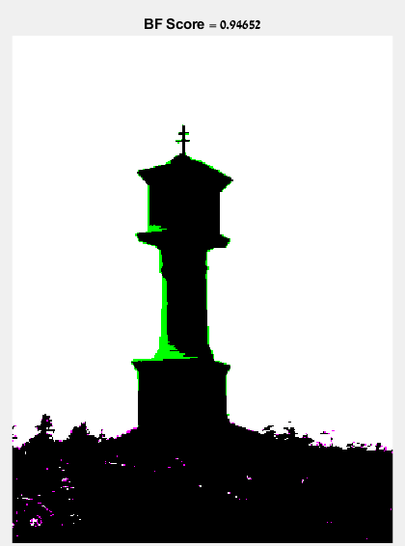
Results- Max entropy VS. ground truth image
Using bfscore built-in function in MATLAB:

Slide 5
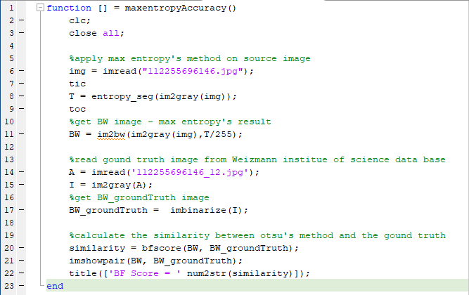
Code:

Slide 6
Speed Results
Speed | Method
0.008089 seconds | Otsu using graythresh (built-in)
0.581840 seconds | Otsu using generalThreshold (my implementation)
0.023001 seconds. | Max entropy (my implementation)
Notes:
I used tic toc built-in methods for measuring the speed

Slide 7
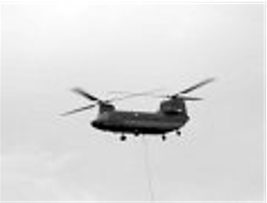

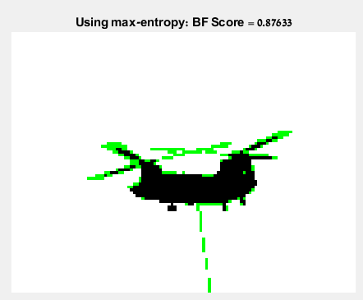
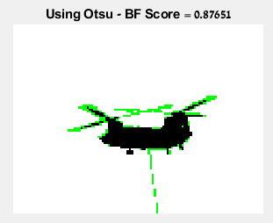
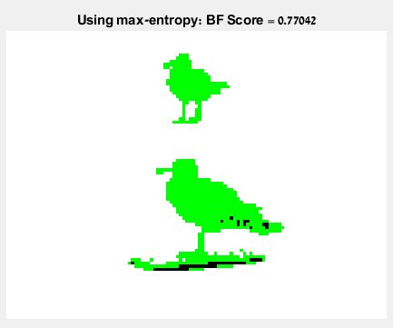
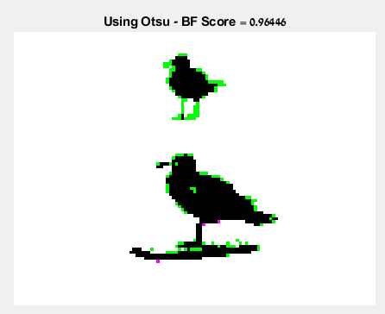
More Comparisons
More Comparisons - Accuracy
Source image 1
Source image 2

Slide 8
More Comparisons
More Comparisons - Speed
Speed |  | Method
Source image2: 0.002609 seconds. | Source image1: 0.018835 seconds. | Otsu using graythresh (built-in)
Source image2: 0.112590 seconds. | Source image1: 0.106028 seconds. | Otsu using generalThreshold (my implementation)
Source image2: 0.000477 seconds. | Source image1: 0.000509 seconds. | Max entropy (my implementation)

Slide 9
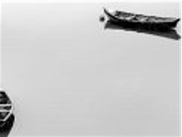
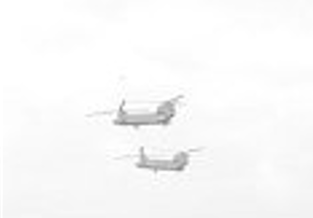
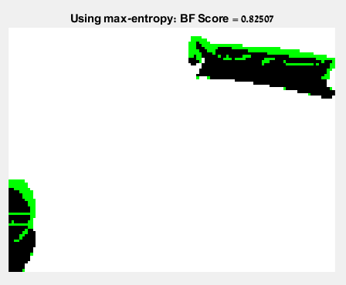
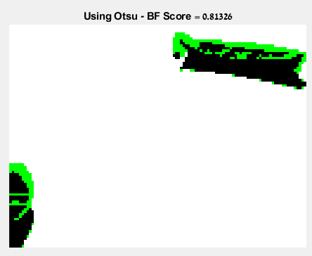
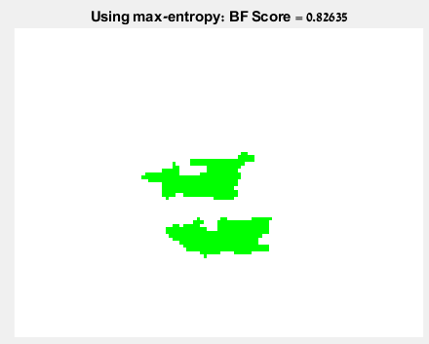
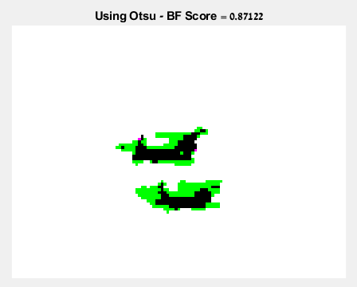
More Comparisons - Accuracy
Source image 1
Source image 2

Slide 10
More Comparisons
More Comparisons - Speed
Speed |  | Method
Source image2: 0.000304 seconds. | Source image1: 0.000560 seconds. | Otsu using graythresh (built-in)
Source image2: 0.098135 seconds. | Source image1: 0.149614 seconds. | Otsu using generalThreshold (my implementation)
Source image2: 0.000467 seconds. | Source image1: 0.000454 seconds. | Max entropy (my implementation)
Notes:
אוטסו עם הפונקציה הבנויה, מניב תוצאה לא מדויקת בהשוואה לground truth

Slide 11
To conclude - Accuracy
As we can see, Otsu’s method is more accurate, especially when the object color (the foreground) is similar to the background
When the foreground and background are clearly distinguishable, Otsu is still more suitable, but the differences are negligible

Slide 12
To conclude - Speed
Looking at Otsu using the built-in method, graythresh – the differences are negligible
Using Otsu that I’ve implemented, max-entropy is faster but when it comes to accuracy comparing to the ground-truth image, this implementation returns more accurate results

Slide 13


